Slide 1

OLSRv2 Simulation for MANET
Final presentation

Slide 2
Agenda
Optimized Link State Routing Protocol Ver. 2
Project description
The Simulator
Protocol Analysis & Observations
Questions & Open Discussion

Slide 3
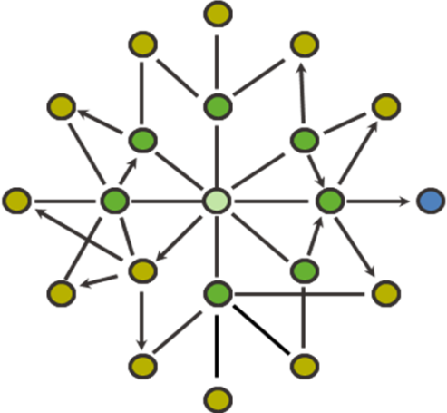
Optimized Link Status Protocol
Based on 1-hop & 2-hop Neighbors sets
Neighborhood knowledge is achieved using NHDP (Hello messages HB)
Multi Point Relay set

Slide 4
Optimized Link Status Protocol
MPR
Each node notifies its MPR set for their nomination (Using TC message flooding)
MPRs broadcast their new role
All nodes can now build a routing table
MPR
Target
MPR
MPR
MPR
Source
MPR

Slide 5
Project Description
Project scope
Simulating MANET environment implementing OLSRv2 protocol
Event driven simulator
Dynamic topology
Topology layouts
Uniform
clusters
MPR selection
Fully configurable (protocol, world parameters)

Slide 6
Protocol Analysis
Minimal MPR selection is has 25% better utility then selecting all neighbors as MPRs
500x500 world size, 30 stations,
reception radius 100, Hello intervals 30
TC intervals 90

Slide 7
Protocol Analysis Cont.
Sending data packets through MPRs does not improve the utilization. (Even lowers it slightly)
Cluster topology has drastic effect on utilization, especially with higher data packet rates
500x500 world size, 30 stations,
reception radius 100, Hello intervals 30
TC intervals 90

Slide 8
Protocol Analysis Cont.
Cluster topology utilization is much lower as expected due to “bottleneck” phenomenon. Selecting a larger MPR set actually helps in these topology layouts.
500x500 world size, 30 stations,
reception radius 100, Hello intervals 30
TC intervals 90

Slide 9
Protocol Analysis Cont.
Setup
Static – Hello interval: 1000, TC interval: 2500
Dynamic – Hello interval: 300, TC interval: 900

Slide 10
Protocol Architecture
Log
GUI
GUI
Log
OLSR Nodes
Event Gen
Topology Mgr
Tasks Queue
Dispatcher
Tasks Queue
OLSRv2 Layer
(per node)
Event Generator
Dispatcher
Topology Manager

Slide 11
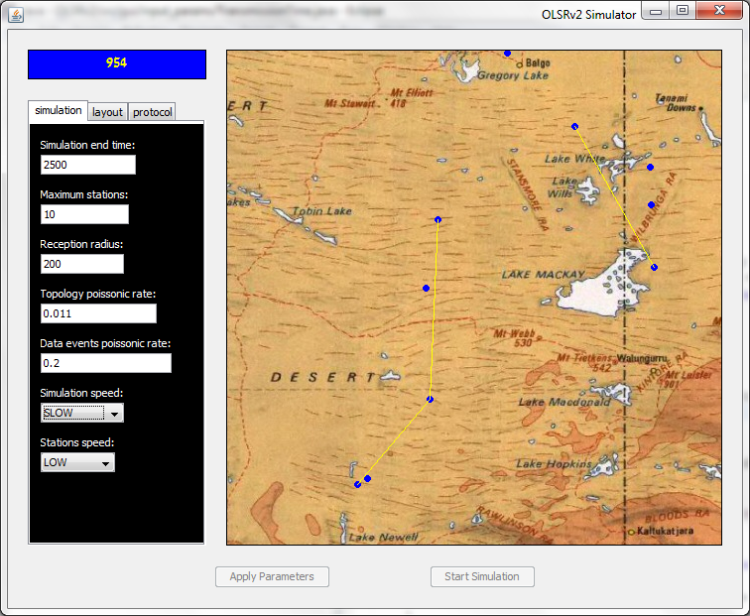
The Simulator
Different parameters
Simulation Time
Data Transfer Between Stations

Slide 12
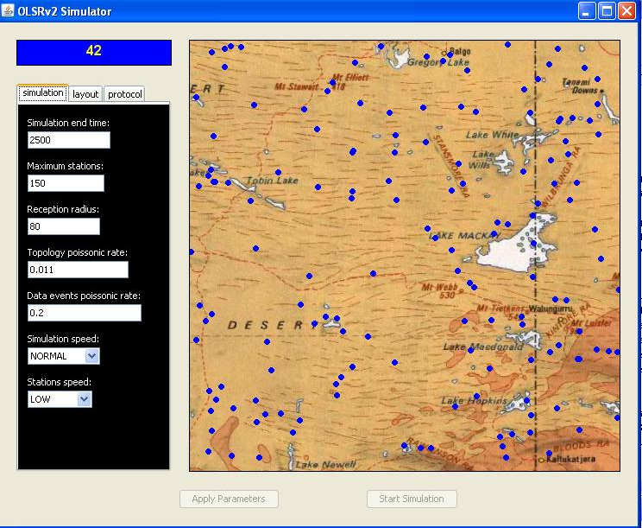
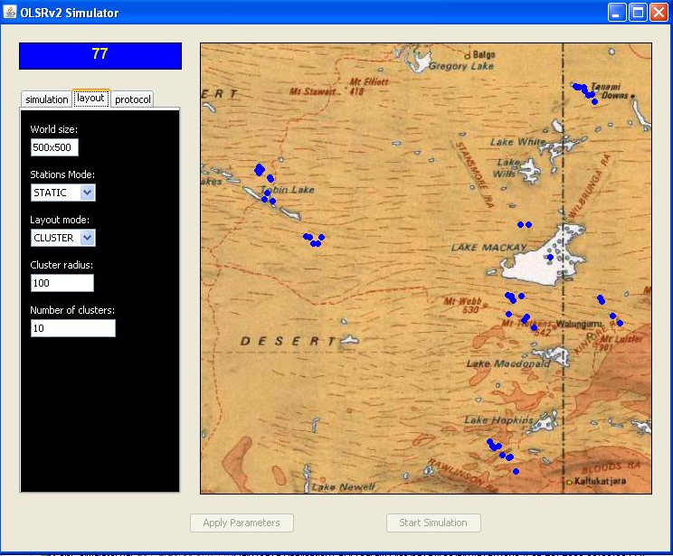
The Simulator Cont.
Cluster Distribition
Uniform formation

Slide 13
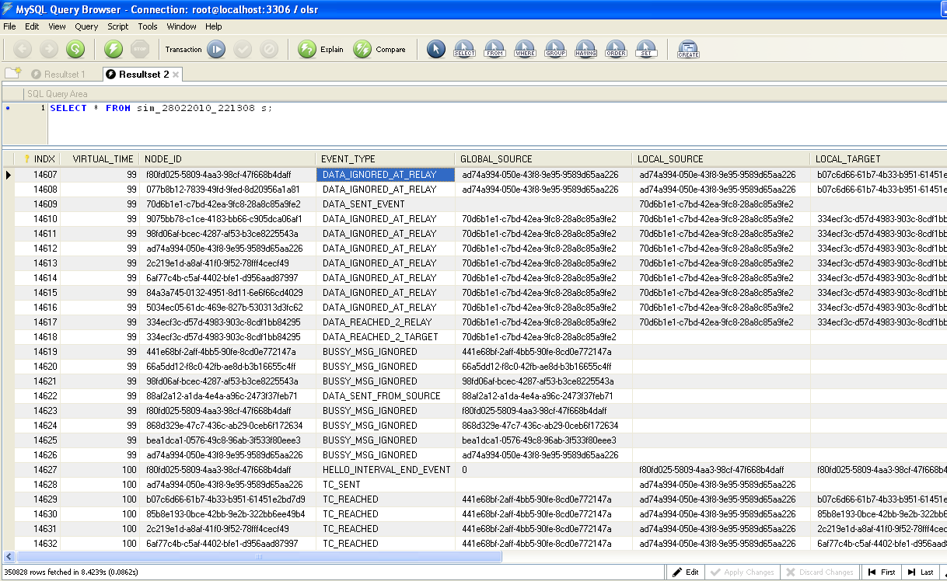
The Simulator – Logger &SQL
Data Send & Receive
Congestion Ctrl.
TC Msg. Send & Receive

Slide 14
Questions
&
Open Discussion

Slide 15
Thank you !
Assaf Israel
Eli Nazarov
Asi Bross

